Slide 1


Windows CE Graphics
Murtuza S Naguthanawala
Program Manager
Microsoft Corporation

Slide 2
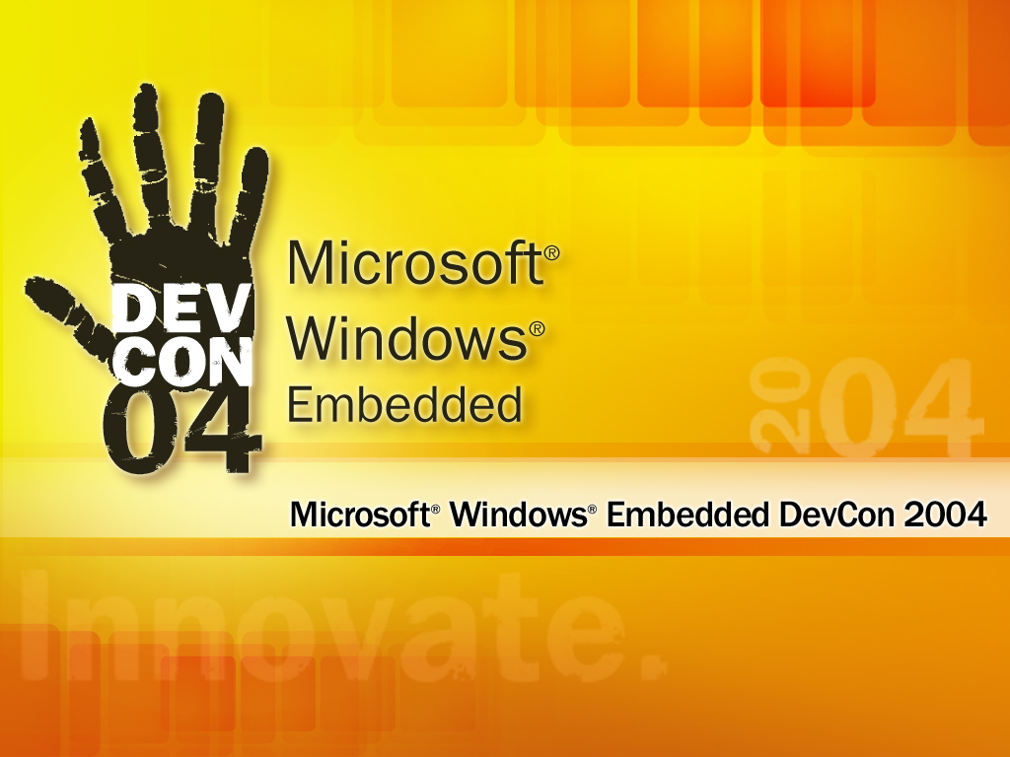

Slide 3



Agenda
  Performance tools
    Monte Carlo Profiler
    DispPerf
    GDIPerfTool
  GDI/DDraw performance guidelines
  Generated Blts
  Code samples – Display Driver

Slide 4
Monte Carlo Profiler
Enable Profiling box in PB
  Sets IMGPROFILER=1
Run system call profiling
  Press the F9 key to start system call profiling
  Press F12 to stop profiling

Slide 5
DispPerf
Ability to profile the display driver only
Identifies ROPs called during an operation
Builds a table that lists the following for each raster operation (ROP) code that is profiled
  Frequency count
  Elapsed time in microseconds
  Average elapsed time in microseconds

Slide 6
Enabling DispPerf
Steps
  Set DO_DISPPERF=1
  Rebuild display driver components
    GPE, EMUL, EMULROTATE,EMULSTUB, DDGPE, GENBLT, AABLT
  Build DISPPERF.EXE
  MAKEIMG
Code example shows how the driver calls DispPerfStart
    SCODE ATI::BltPrepare(GPEBltParms *pBltParms)
      { DispPerfStart (pBltParms->rop4);
      pBltParms->pBlt = EmulatedBlt; // Catch all }
Code example shows how the driver calls DispPerfType
    // Performance Logging Type
    if (pBltParms->pBlt != EmulatedBlt) { DispPerfType(DISPPERF_ACCEL_HARDWARE); }
When the blit operation completes, call DispPerfEnd() function

Slide 7


Profiling Tools

Slide 8

Graphics Performance Tool
Issue
  Nuts and bolts story for graphics performance did not go into the level of granularity to diagnose and analyze performance issues
Solution/Goal
  Create a tool that allows you to measure graphics performance for GDI APIs for all CE platforms
  Eliminate dependency on complex server based setup and hardware to measure graphics performance
    WINBENCH and IE need networking and a separate server
  Help display driver developers see how graphics operations are performed (in S/W or in H/W) and identify areas that should be accelerated

Slide 9


Graphics Performance Tool
Architecture
  Loader application
  Graphics scenario script
  Output Engine
Loader application
  The application loads the scripts and executes the test
  Will run on all CPUs and on Pocket PC (magneto and later) and Smartphone
  Hooks into DISPPERF utility to report driver statistics
    cGPE cEmul cHardware added to output

Slide 10
Graphics Performance Tool
Graphics scenario script
  Identifies the graphics operations to be performed for the performance run
    Specify the APIs and the parameters to run
  Text based script
  Script files mimic real graphics scenarios
    RDP script was created by running RDP on CEPC to identify the top graphic operations and then logged into the script file
Output engine
  Data is logged into logresult.csv file which can be easily loaded/manipulated in Excel

Slide 11
Sample Script File
Simple script file to test a BitBlt SRCCOPY from video memory to video memory
    BOOL BitBlt( HDC hdcDest, int nXDest, int nYDest, int nWidth, int nHeight, HDC hdcSrc, int nXSrc, int nYSrc, DWORD dwRop );
    [BitBlt]
    ROP=0x00CC0000
    Source=Video_Memory, System_Memory
    Dest=Primary, System_Memory
    Brush=NULL
    Coordinates=0,0,100,100,100,100

Slide 12
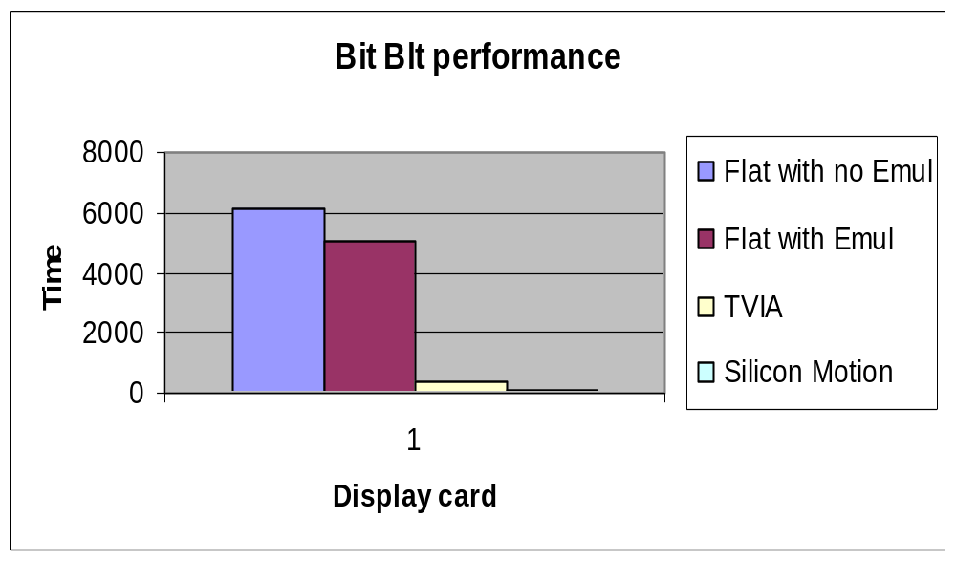
Test Results For BitBlt

Slide 13
Graphics Perf Demo

Slide 14
General Blitting
System to System memory
  Resulting in CPU handling the operation
  memcpy kind of performance
System to Video memory
  Can be slow due to bus transfers,
  In case of UMA it is similar to system to system performance
  DMA could add significant performance improvements
Video to Video Memory
  Generally fast (when ROP is implemented in hardware)
    You could run into situations where ROP is not implemented in hardware

Slide 15
Importance Of Drivers
Acceleration must be fully exploited and explored
  Profile scenarios for most common ROPs
  Check hardware manuals for the chipsets
Do not use FLAT, there is no acceleration
  Just for reference
Performance depends on
  Acceleration features available
  Video Memory Blts supported
  System Interface used (PCI, AGP)
  CPU speed
  Video memory speed
Use CETK verified drivers, encourage IHVs to pass CETK tests

Slide 16
Display Driver
Accelerating Lines
  SCODE ATI::Line(GPELineParms *pLineParms, EGPEPhase phase)
  {
  if (phase == gpeSingle || phase == gpePrepare) {
  pLineParms->pLine = EmulatedLine;
  if (((ATISurf*)(pLineParms->pDst))->InVideoMemory() &&
  pLineParms->mix == 0x0d0d)
  {
  pLineParms->pLine = (SCODE (GPE::*)(struct GPELineParms *))
  AcceleratedSolidLine;
  }
  return S_OK;
  }

Slide 17
Accelerating Blts
SCODE ATI::BltPrepare(GPEBltParms *pBltParms)
{
pBltParms->pBlt = EmulatedBlt; // Generic BLT processing
if (((ATISurf*)(pBltParms->pDst))->InVideoMemory() ) {
switch( pBltParms->rop4 ) {
case 0x0000:// BLACKNESS
pBltParms->solidColor = 0x0;
pBltParms->pBlt = (SCODE (GPE::*) (struct GPEBltParms *)) AcceleratedFillRect;
break;
case 0x6666:
case 0x8888:
case 0xCCCC:
case 0xEEEE:
if (!pBltParms->pSrc->InVideoMemory() || pBltParms->pLookup || pBltParms->pConvert ||
pBltParms->bltFlags & BLT_STRETCH)
break;
pBltParms->pBlt = (SCODE (GPE::*)(struct GPEBltParms *)) AcceleratedSrcCopyBlt;
break;
…..
}

Slide 18
Graphics Optimizations
Off screen surfaces
  Used when you have lot of animations etc
Bliting
  CreateCompatibleBitmap
    Surface in video memory if video memory available
  CreateBitmap
    Surface in System memory

Slide 19
Optimization
LoadBitmap returns an HBITMAP in whatever format the resource is in
    This results in a color converting blt most of the time
    Cache a compatible bitmap instead
      If a particular blt is going to be performed frequently, call CreateCompatibleBitmap to create a bitmap that's compatible to the destination surface and use the compatible bitmap instead of the original bitmap
Stretching
  If a bitmap is going to be stretched to the same size many times consider caching
Complex clip regions
  Uses a mask surface and MaskBlt

Slide 20
Optimization Techniques
Destination reads
  CreateCompatibleBitmap can hurt if no hardware acceleration available
    Access to video memory is typically slower than system memory for the CPU
  Drivers that use all software blitting should avoid exposing "video" memory

Slide 21
Optimizations -- Windowing System
Use hardware cursor functionality
  Override
    GPE::SetPointerShape
    GPE::MovePointer
Hardware lines (stroked path)
  Override GPE::Line
Most Important Blits:
  Rectangular color fill (PATCOPY)
  Text = 0xAAF0 masked PATCOPY
  SRCCOPY = 0xAA00

Slide 22
Optimizations -- Windowing System
DrawIconEx
  BOOL DrawIconEx ( HDC hdc, int xLeft, int yTop, HICON hIcon, int cxWidth, int cyWidth, UINT istepIfAniCur, HBRUSH hbrFlickerFreeDraw, UINT diFlags );
  Not Masked 0xAACC or color key!
  First pass: 1Bpp->Screen SRCAND
  Second pass: 8Bpp->Screen SRCINVERT
  Only DI_NORMAL supported
Shell uses DrawIconEx to paint desktop and other icons

Slide 23
Optimizations -- Windowing System
ImageList (hardest to accelerate)
  BOOL WINAPI ImageList_Draw (HIMAGELIST himl, int i, HDC hdcDst, int x, int y, UINT fStyle );
  Each image in the list consists of a mask and an image
    ILD_MASK (Draw mask only)
    ILD_NORMAL (Draw image only)
    ILD_TRANSPARENT
    White B/G = MERGEPAINT mask, SRCAND image
    Black B/G = SRCAND mask, SRCPAINT image
    Otherwise: DSna mask to image, SRCAND mask, then SRCPAINT image

Slide 24
Optimizations -- Browser
GIF = 8Bpp -> Screen SRCCOPY
Animated GIF potential 0xAACC
Single color GIFs = PATFILL
JPEG = 16/32 Bpp -> Screen SRCCOPY
If Screen = 8bpp, IE will dither

Slide 25
Optimizations -- DirectDraw
Blitting
  Driver should only optimize blits necessary for application(s)
  Color conversion forbidden in Ddraw
  Control source and destination types in CreateSurface
    May fail everything in system memory
  CE added AlphaBlt
Implement a good flip
  Don’t busywait, Use vsync interrupts
  Do so for all overlays as well
  Try not to return DDERR_WASSTILLDRAWING: causes the DirectDraw middleware to busywait
Overlays
  Batch UpdateOverlay calls to make all changes during vsync
  Windows CE has alpha-blended overlays

Slide 26
Optimizations – Video Playback
Video renderer is highly generalized
  Will use best combination of features
    YUV flipping overlays are best
    Single YUV overlay is second best
    RGB flipping overlays next
    Single RGB overlay
    DirectDraw blit to screen
    GDI blit to screen

Slide 27
Optimizations – Video Playback
Must have right caps set
    DDCAPS_OVERLAY
    DDCAPS_OVERLAYSTRETCH is used
    DDCKEYCAPS_DESTOVERLAY is very useful
Support the YUYV and UYUV FourCC codes
    Allows video renderer to create YUV surfaces
For YUV flipping overlays
  Make sure you implement a YUV->YUV SRCCOPY blit for temporal compression codecs (DDCAPS2_COPYFOURCC) Blit front to back buffer to read back previous frame

Slide 28
Display Drivers-Blt Generation
Issues
  We have three emulation libraries today,
    EMUL.LIB, SWG.LIB (retired in Macallan) and AnyBlt() in GPE
  All ROPs are not optimized
    Few select ROPs are optimized in EMUL.LIB
    Rest go to AnyBlt()
Goal/Solution
  Consolidate all software emulation ROP processing into a single extensible library and provide optimized solution for all graphics operations
  Allow CPU vendors to take advantage of CPU specific features for optimizations

Slide 29
Blt Generation-Benefits
Optimizes all ROPs
  Faster processing of ROPs and enhanced performance for many ROPs
    Minimizes branches in the inner loop
Easily extensible
  We can extend support for new functionality with minimal effort
Seen significant gains in color conversion
Allows OEMs to provide their own CPU dependant optimized machine code for their CPUs
Will retire EMUL.LIB and AnyBlt ( ) in future releases
  SWG is retired for Macallan

Slide 30
Generated Blts
Each blt function is
  Generated in a machine independent pCode
  pCode is then translated into machine code before being executed
  To improve performance of individual blt functions, the translated machine dependent code is stored in a cache
  If a function in the cache is used often enough additional optimizations may be performed to further increase performance

Slide 31
Generated Blts
GenBltCpuInitialize ( )
  Called to retrieve the appropriate translator and optimizer functions.
    public\common\oak\cpulibs\%_TGTCPUFAMILY%\genblt_cpu.
  IsProcessorFeaturePresent
    Check if processor family supports GeneratedBlts
  Translator functions
    GenBltCpuFuncs::pfnPCodeToCpuCode
      Called once
      GenBlt”cpuname”Translate is the function used for ARM and x86
    Optimizer functions
      GenBltCpuFuncs::pfnCpuOptimize
      GenBlt”cpu”Optimize is used for ARM and x86

Slide 32
Code For Armv4 Blt Generation
GenBltCpuInitialize( GenBltCpuFuncs * pCpuFuncs )
  {
  BOOL fResult = FALSE;
  <<<<<<< Insert code here to add additional CPU support>>>>>>>>
  // Detect various ARM variants and select the best translator and optimizer.
  if (IsProcessorFeaturePresent(PF_ARM_V4))
  {
  pCpuFuncs->pfnPCodeToCpuCode = GenBltArmV4Translate;
  pCpuFuncs->pfnCpuOptimize = GenBltArmV4Optimize;
  fResult = TRUE;
  }
  else
  {
  RETAILMSG(1, (L"GenBlt: Attempting to use ARM specific code on an unsupported CPU"));
  }
  // Returning FALSE here means that GeneratedBlts will not be used
  return fResult;
  }

Slide 33
Add ARMV5 Functions To The Current ARM CPU library
GenBltCpuInitialize(GenBltCpuFuncs * pCpuFuncs )
  {
  …………..
  ……………
  if (IsProcessorFeaturePresent(PF_ARM_V5))
  {
  pCpuFuncs->pfnPCodeToCpuCode = GenBltArmV5Translate;
  pCpuFuncs->pfnCpuOptimize = GenBltArmV5Optimize;
  pCpuFuncs->dwOptimizeTimes[0] = 10;
  pCpuFuncs->dwOptimizeTimes[1] = 25
  fResult = TRUE;
  }
  …………….
  ……………

Slide 34
Reference Files
public\common\oak\inc\genblt.h
    This is the main header file for GeneratedBlts.
public\common\oak\inc\genblt_pcode.h
    This header file contains the definition of the p-code language as well as macros an functions for common tasks.
public\common\oak\cpulibs\common\genblt_cpu\pcvm.cpp
    The p-code virtual machine should be used as a definition for the behavior of each p- code instruction.
public\common\oak\cpulibs\x86\genblt_cpu\genblt_x86.cpp
  This is the x86 version of GenBltCpuInitialize.
public\common\oak\cpulibs\x86\genblt_cpu\trans_x86.cpp
  This is the generic x86 p-code to machine code translator.
public\common\oak\cpulibs\arm\genblt_cpu\genblt_arm.cpp
  This is the ARMV4 version of GenBltCpuInitialize.

Slide 35

©2004 Microsoft Corporation. All rights reserved.
This presentation is for informational purposes only. Microsoft makes no warranties, express or implied, in this summary.

